Slide 1
Campaign Consulting Proposal
Tyler Kline

Slide 2
Agenda
Introduction
Voter Prediction Model
Demographic Model
Donation Rates
Voter Clustering Model
Services and Product Offerings

Slide 3
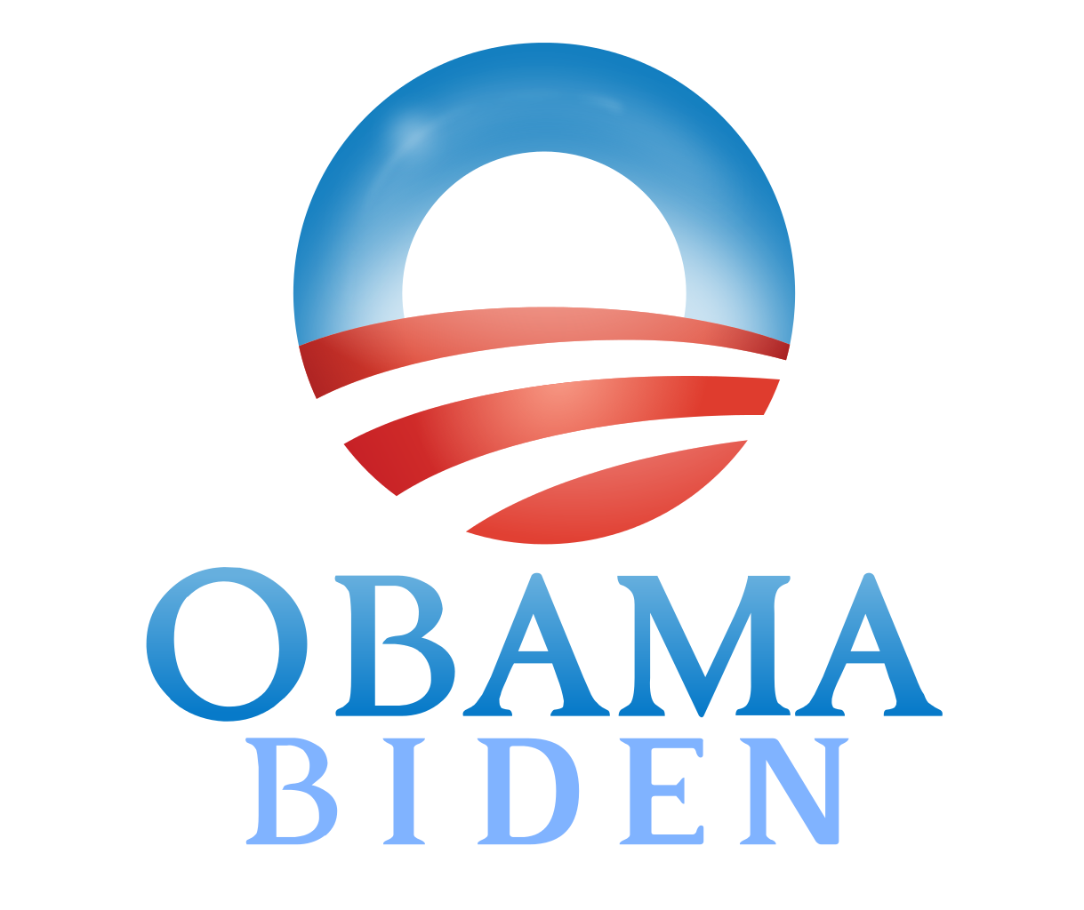
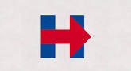
Introduction - Background
Over the past several years, statistical modeling and analytics have become increasingly critical to major campaigns across the country
2012
2016
“In 2012, the Obama Campaign used data analytics and experimental methods to assemble a winning coalition vote by vote”
“The campaign didn’t just know who you were; it knew exactly how it could turn you into the type of person it wanted you to be
Source: “How Obama’s Team used Big Data to Rally Voters” https://www.technologyreview.com/s/509026/how-obamas-team-used-big-data-to-rally-voters/
“Analytics, as it did in 2012, is playing an important role for mass voter persuasion in the U.S. presidential race”
“It’s a numbers game: Predictive analytics targets campaign activities, strengthening a campaigns army of volunteers by driving its activities more optimally”
Source: “How Hilary’s Campaign Is (Almost Certainly) Using Big Data” https://blogs.scientificamerican.com/guest-blog/how-hillary-s-campaign-is-almost-certainly-using-big-data/
However, city-level elections have not seen the same proliferation of data and analytics in campaigns

Slide 4
Introduction - Background
Several data sources and tools offer city-level campaigns the same opportunity to take advantage of the data science revolution
Google Geo-Coding API
NYCCFB Financial Disclosures
NYS BOE Voter Data
NYC BOE Voter Data
Census Data
NYC 311 Call log Data
Polling Locations
Analytics
Voter Predictions
Geo-coded Voter Address
Centralized DB
Voter Issues (311 calls)
Demographics (ethnicity/age)
Voter Donation Behaviors
Voter “Clusters”

Slide 5
Agenda
Introduction
Voter Prediction Model
Demographic Model
Donation Rates
Voter Clustering Model
Services and Product Offerings

Slide 6
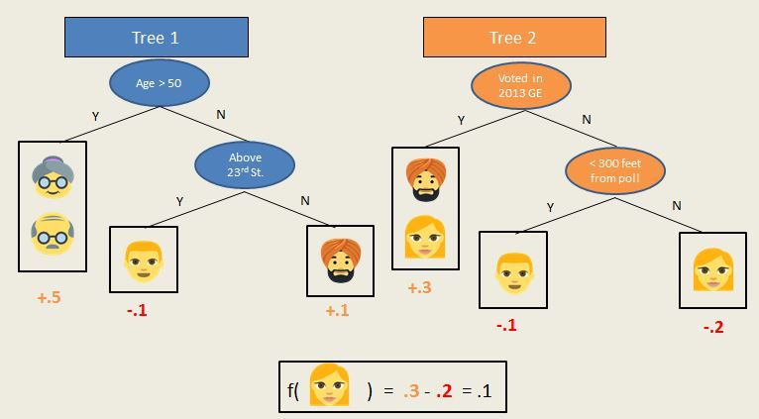
Voter Prediction Model – Decision Tree
One way we can apply analytics to city-level elections is to predict voting behavior for individuals. This can be done by using a regression tree-based machine learning model:
1) Decision tree learning uses a decision tree as a predictive model which maps observations about an item to conclusions about the item's target value
2) Observations about a person are represented in the branches to make conclusions about them
3) This allows us to statistically predict the likelihood of an individual voter's turnout

Slide 7
Voter Prediction Model
Using voter history and previous elections results, we can try to predict historical and future voting behavior for each registered voter
Voting History
Election Results
Voter ID | Turnout | Rosie Mendez | Richard Del Rio
123456 | .91 | .56 | .27
% likelihood person will vote in specific election
% likelihood person voted for Rosie Mendez in 2013 Primary
% likelihood person voted for Richard Del Rio in 2013 Primary

Slide 8
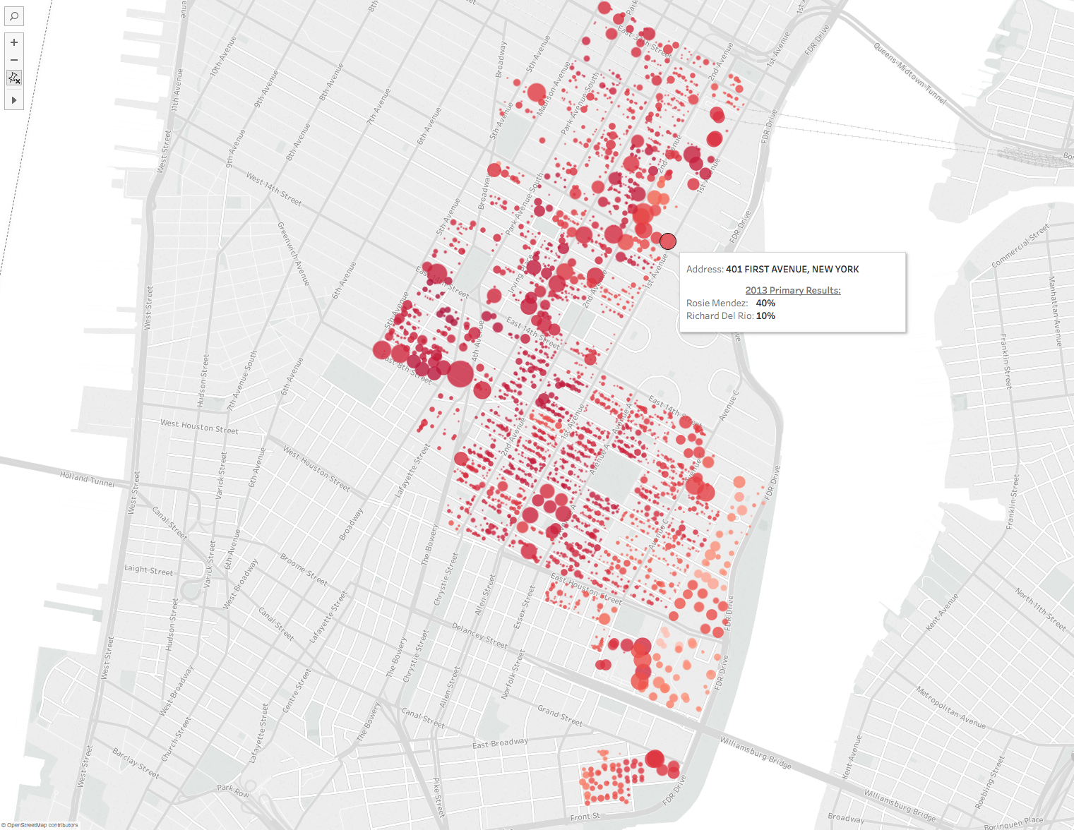
Voter Prediction Model
These models can be used to predict turnout and likely voting choices from previous elections
NYC BOE Voter Data
Census Demographic Data

Slide 9
Agenda
Introduction 10 min
Voter Prediction Model 10 min
Demographic Model 10 min
Donation Analysis 10 min
Voter Clustering Model 10 min
311 Call Analysis 10 min
Services and Product Offerings 10 min

Slide 10
Demographic Model
Using similar machine learning models, we’re able to classify and predict voter demographics based on names and age
NYC BOE Voter Data
Census Demographic Data
Greater African
Asian
Muslim
African
Greater East Asian
Indian
Greater European
Japanese
East Asian
Western European
Eastern European
British
Jewish
Italian
Hispanic
Nordic
French
German

Slide 11
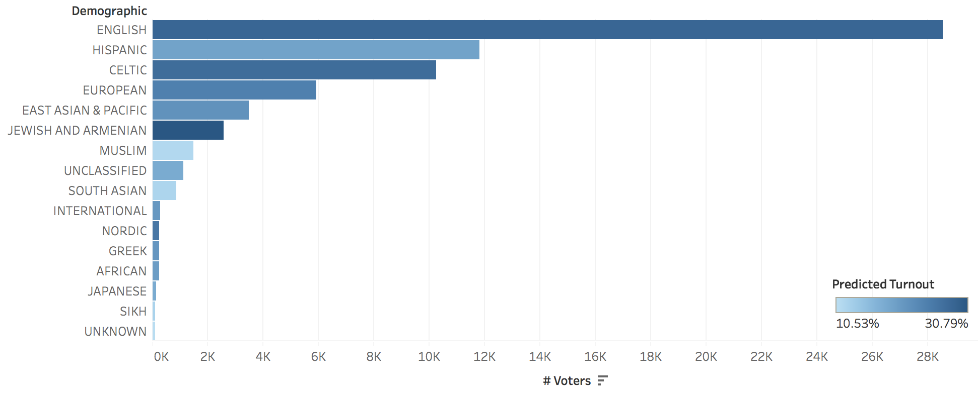
Demographic Model – Sample Results
Understanding voter demographics allows our predictions to be more accurate and granular.
District 2: Predicted Voter Turnout
Our table shows predicted voter turnout and counts by demographic
More granular results enables opportunities for unique and personalized voter outreach efforts (i.e. personalized direct mail/email, targeted phone banking and canvassing, custom campaign event planning

Slide 12
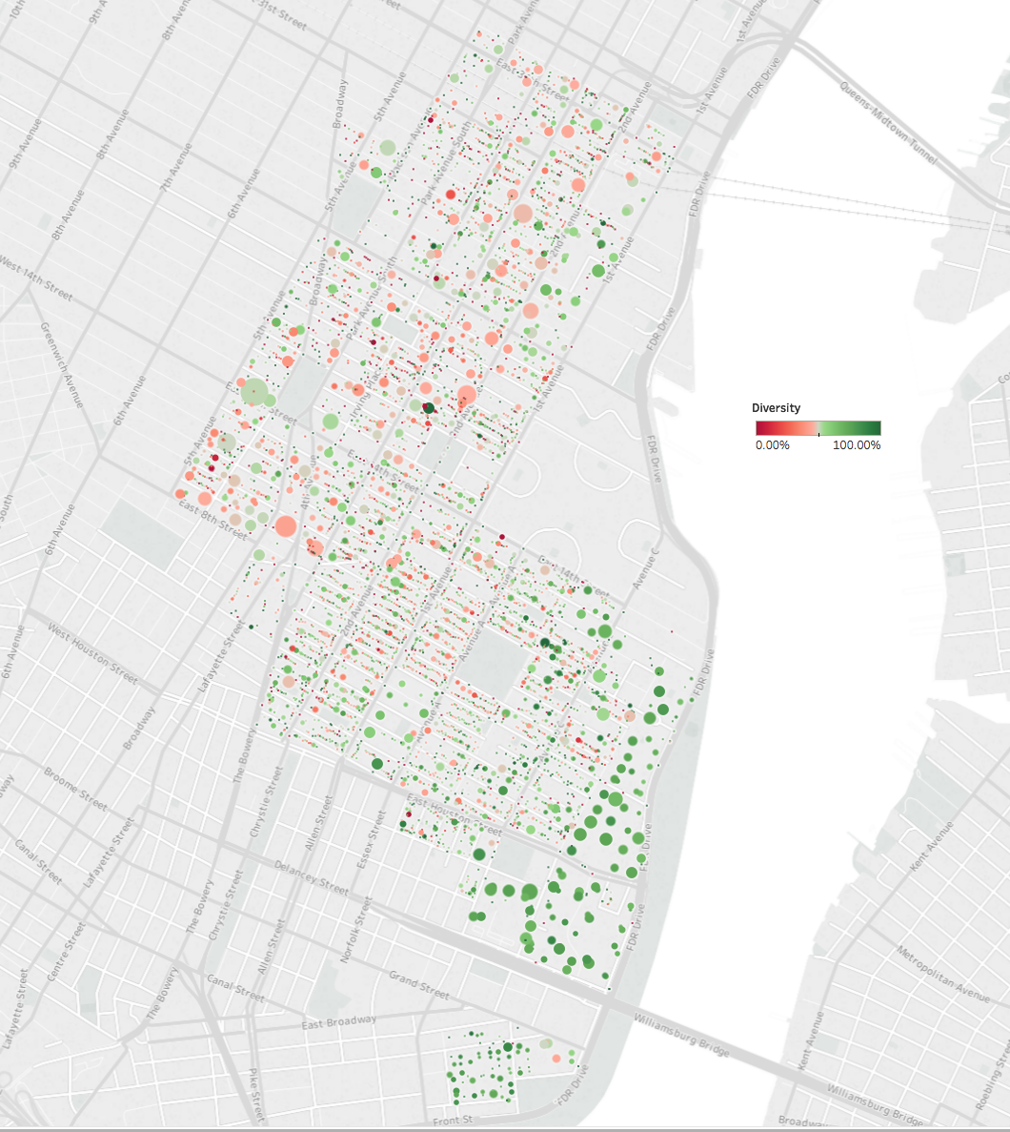
Demographic Model – Sample Results
We can also strategize voter outreach efforts around demographics of specific buildings
District 2 Demographics by building
Predicted Turnout (circle size)
Demographic makeup (color-scale). Red=greater uniformity

Slide 13
Agenda
Introduction 10 min
Voter Prediction Model 10 min
Demographic Model 10 min
Donation Analysis 10 min
Voter Clustering Model 10 min
311 Call Analysis 10 min
Services and Product Offerings 10 min

Slide 14
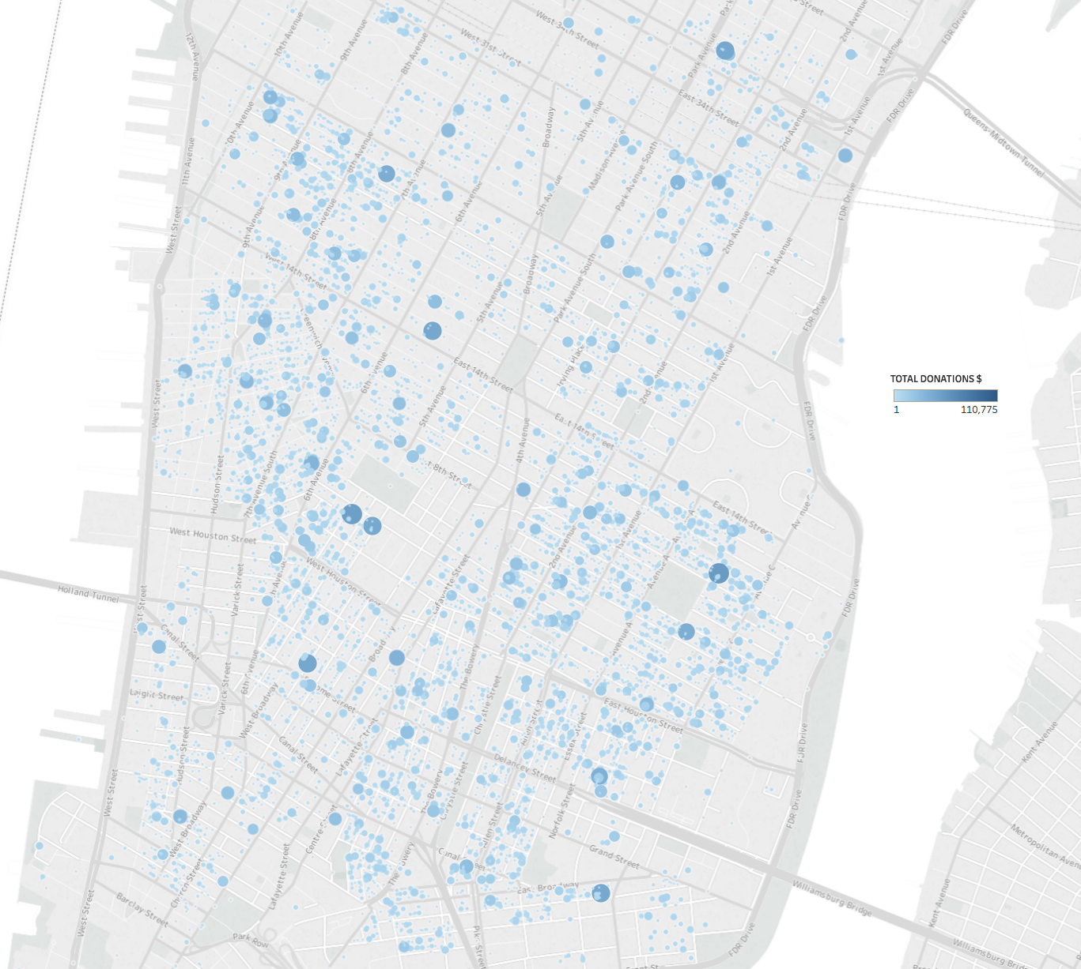
Donation Analysis
Combining NYCCFB data with voter data adds another layer to our analysis. Understanding where donations come from can help focus campaign efforts
Manhattan Registered Voter
Donation Totals by Address
Donation Analysis can help us answer new types of questions:
Which primary voters likely donated to a competitor?
How can we focus our efforts to grow our donor base?
Which neighborhoods are our competitors targeting?
This map shows donation totals by address (larger bubbles = larger totals)

Slide 15
Agenda
Introduction 10 min
Voter Prediction Model 10 min
Demographic Model 10 min
Donation Rates 10 min
Voter Clustering Model 10 min
311 Call Analysis 10 min
Services and Product Offerings 10 min

Slide 16
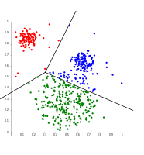
Voter Clustering Model
Using a machine learning method called k-means clustering, we can segment voters into unique clusters based on statistically significant data points
K-Means Clustering
Sample Voter Clusters
Avg. Age: 28
Turnout Prediction: 20%
Female: 66%
Hispanic: 8%
Avg. Age: 38
Turnout Prediction: 40%
Female: 26%
Hispanic: 28%
Avg. Age: 68
Turnout Prediction: 60%
Female: 46%
Hispanic: 12%
Voter clusters can be used to create customized voter outreach efforts (i.e. personalized direct mail/email, targeted phone banking and canvassing, custom campaign event planning

Slide 17
Agenda
Introduction 10 min
Voter Prediction Model 10 min
Demographic Model 10 min
Donation Rates 10 min
Voter Clustering Model 10 min
311 Call Analysis 10 min
Services and Product Offerings 10 min

Slide 18
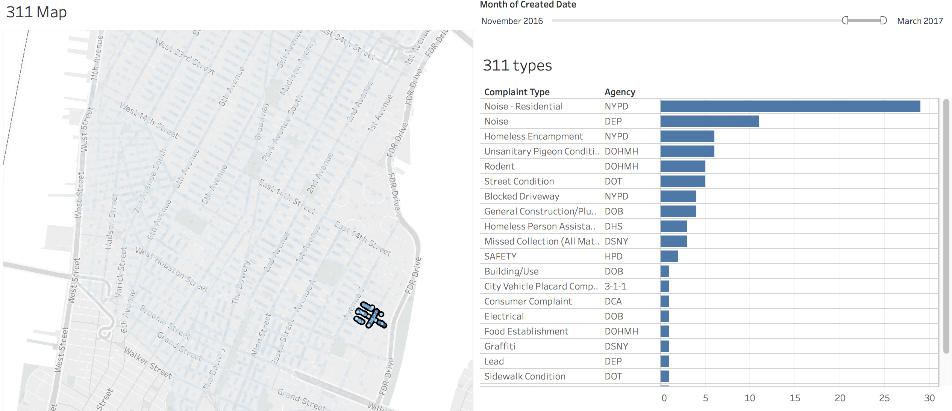
311 Call Analysis
By combining 311 call data with voter data, we can uncover insights on issues that each voter uniquely faces
Connecting 311 calls complaint types to voter data can help us understand issues unique to a given district or individual voter

Slide 19
Agenda
Introduction 10 min
Voter Prediction Model 10 min
Demographic Model 10 min
Donation Rates 10 min
Voter Clustering Model 10 min
311 Call Analysis 10 min
Services and Product Offerings 10 min

Slide 20
Summary
These models and analytics have several areas that can help a New York City Council Campaign win an election
Strategy
Targeting
Understanding Issues
Donor Base Growth
GOTV Efforts
Customized Messaging
Voter density
Voter Demographic composition
Petition
Gathering
Online Ads/Direct Mail

Slide 21
Services and Product Offerings
Offering | Tier 1 | Tier 2 | Tier 3
Individually priced tools | ● | ● | ●
All tools (discounted) | ○ | ● | ●
Raw Data | ○ | ◑ | ●
Custom Reports | ○ | ◑ | ●
Exclusive access within campaign district | ○ | ○ | ●

Slide 22
Appendix

Slide 23
Voter Prediction Model - Accuracy
Understanding how to measure the of accuracy these models is important before building out further use cases:
Typical Model Performance (voter population of 100)
Predictions
 | Vote | No-Vote
Vote | 13 | 8 | 21
No-Vote | 7 | 72 | 79
 | 20 | 80
Actuals

Slide 24
Voter Prediction Model - Accuracy
Depending on how these predictions are used, different measurements of accuracy offer unique tradeoffs:
Non-Voters
Voters
Incorrect
Correct

Slide 25
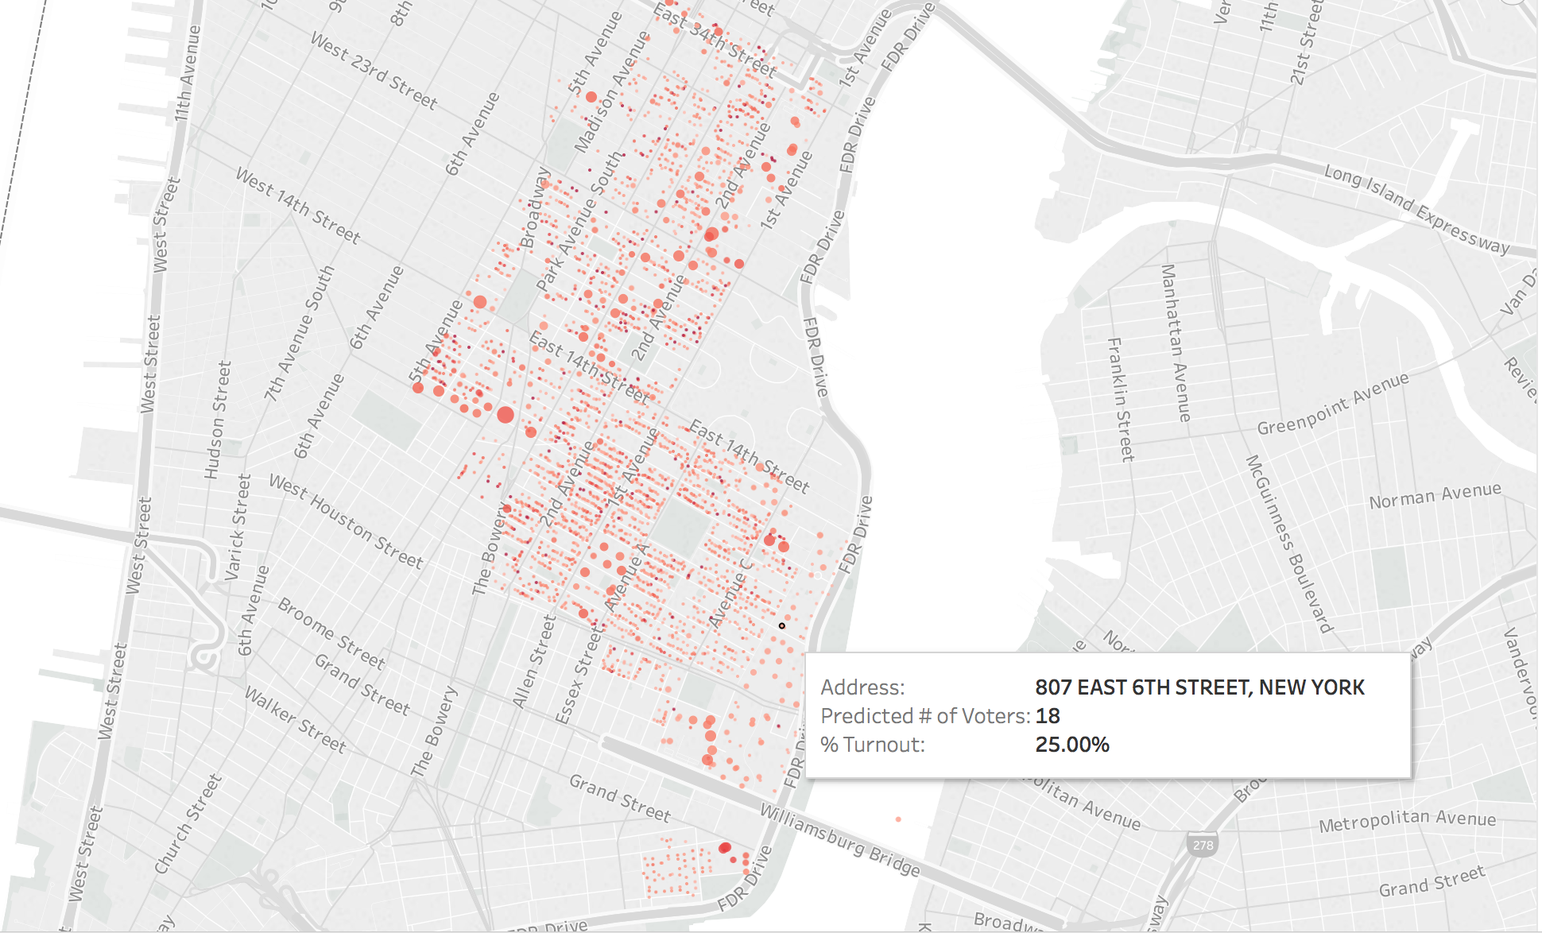
Use Case #1: targeting specific locations based upon likely voters

Slide 26
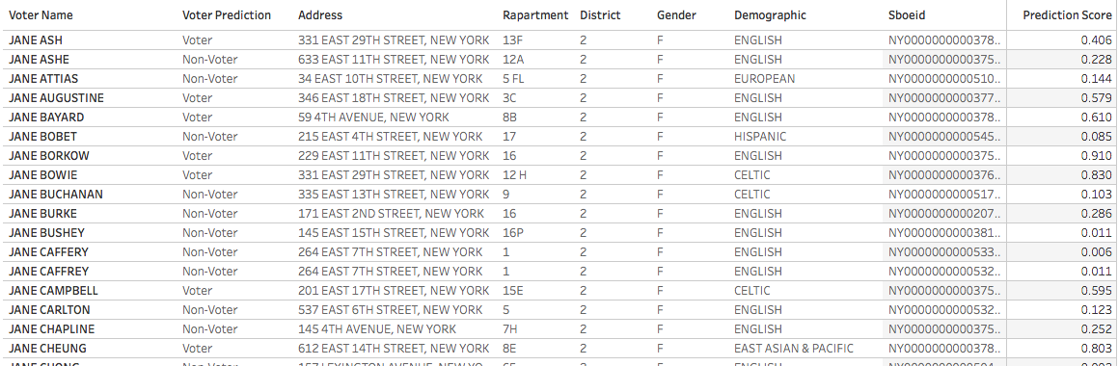
Use Case #2: targeting specific voters for outreach efforts

